Slide 1




Advisory Insights for Social Buzz:
Social media & content creation
Prepared by:
Sanjay Polamarasetti,
Analytics Team, Accenture

Slide 2


Today's agenda
Project recap
Problem
The Analytics tram
Process
Insights
Summary

Slide 3

In this project, I worked with Social Buzz, a rapidly growing social media platform, to analyze and optimize their content creation strategy.
By extracting and cleaning large datasets, I identified key trends, categorized user reactions, and provided data-driven insights to help the company enhance engagement, improve their content strategy, and prepare for their upcoming IPO.
Project Recap

Slide 4

Problem
Over 10000 posts per day
36,500,000 pieces of content per year!
But how to capitalize on it when there is so much?
Analysis to find Social Buzz’s top 5 most popular categories of content

Slide 5


The Analytics team

Slide 6
Data Collection
Process
1
2
Data Cleaning
3
Data Modelling
4
Analysis
5
Insights Extraction

Slide 7

Insights
Category Performance Overview
Top 5 Categories
Reactions across Top 5 Categories
Reactions Trends Overview
Sentiment Analysis
Content Trends by Month
Live Dashboard Link
Summary

Slide 8
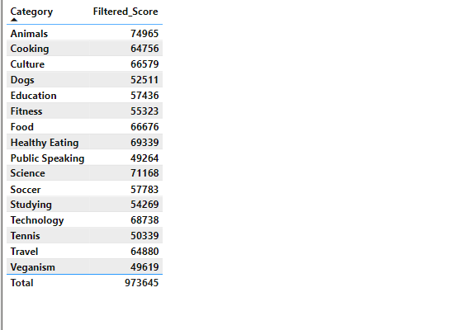

1. Category Performance Overview

Slide 9
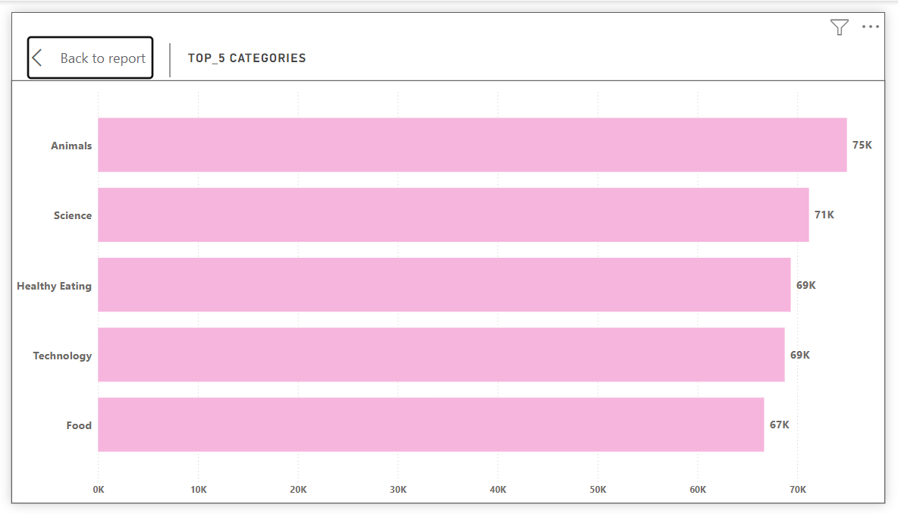
2. Top 5 Categories

Slide 10
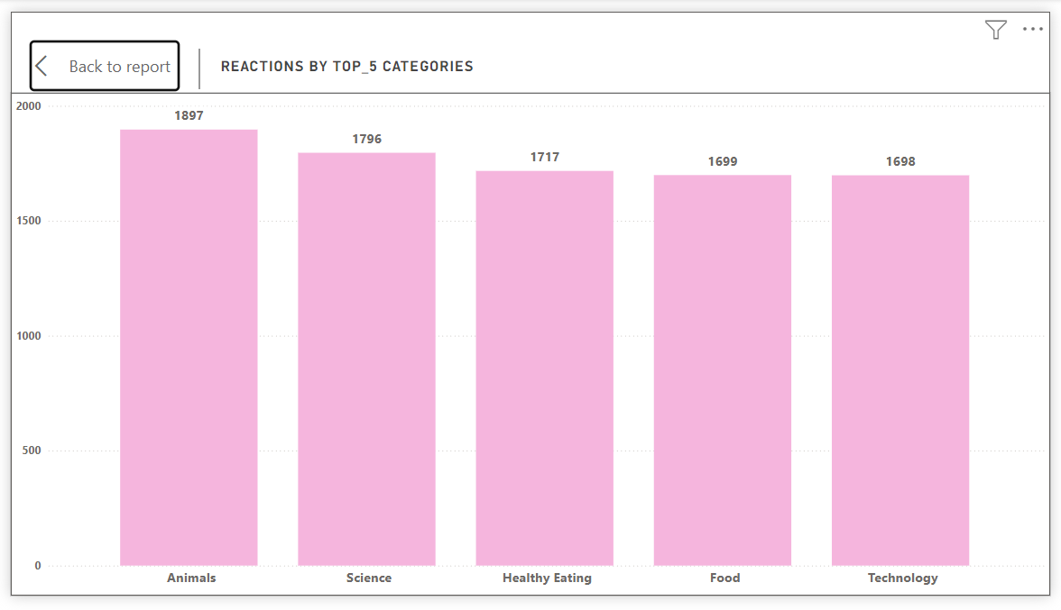
3. Reactions Across Top 5 Categories

Slide 11
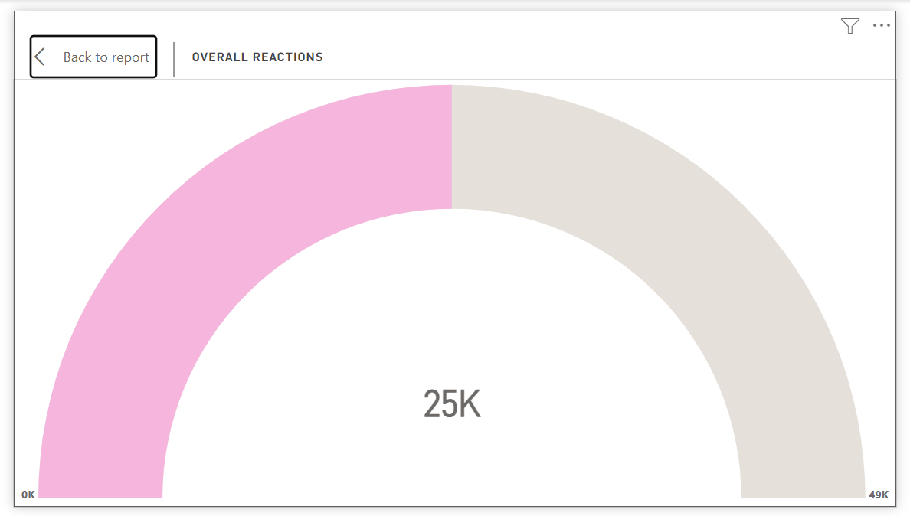
4. Reactions Trends Overview

Slide 12
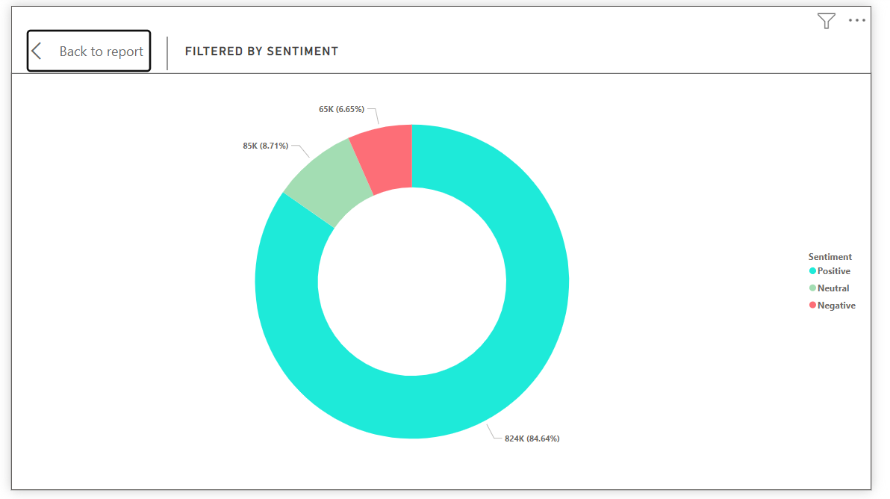
5. Sentiment Analysis

Slide 13
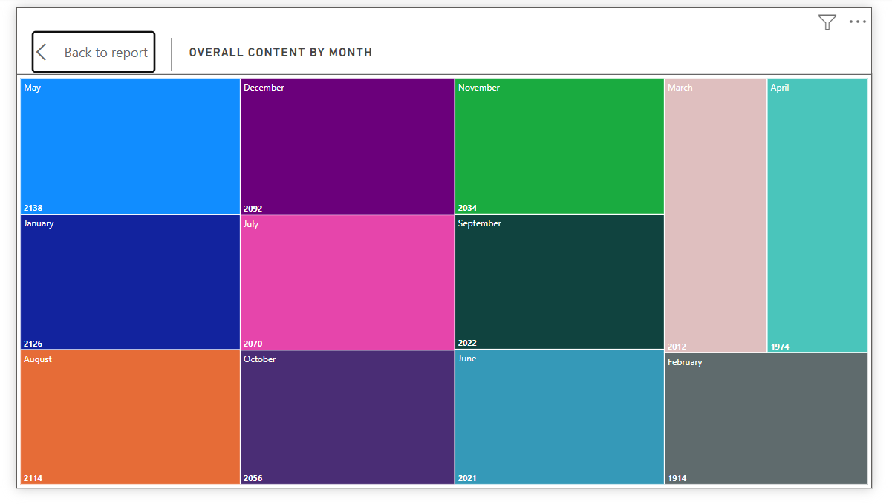
6. Content Trends by Month

Slide 14
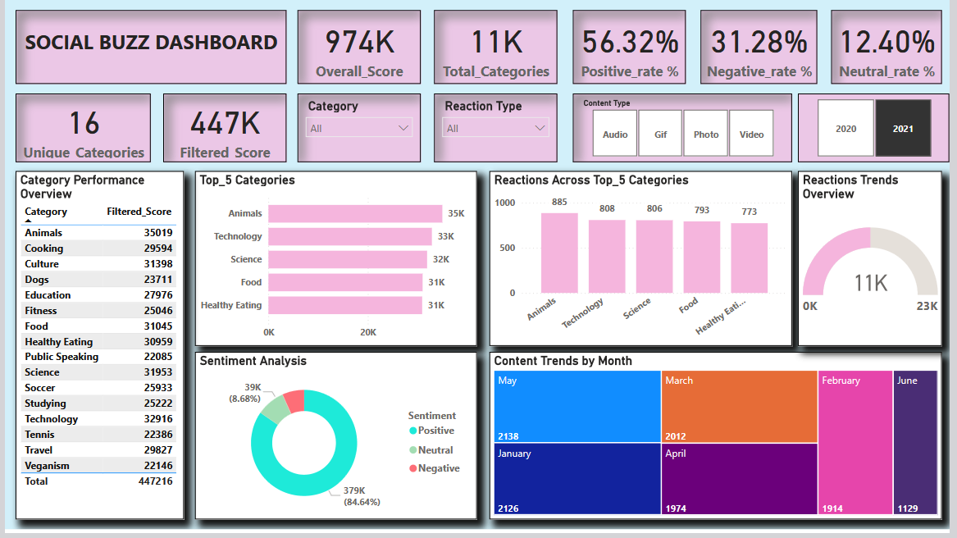
7. Final & Live Dashboard Link : Power BI Live Dashboard

Slide 15

The Social Buzz Dashboard provides an in-depth analysis of user interactions and content performance.
It highlights 16 unique categories with a total score of 974K, emphasizing the Top 5 Categories such as Animals, Science, and Healthy Eating.
Positive sentiment dominates user reactions, accounting for 56.19%, followed by 31.31% negative and 12.50% neutral reactions.
The dashboard also tracks reaction trends across various content types (audio, video, GIFs, and photos) and displays monthly content patterns, showcasing peak activity in May and December.
This comprehensive visualization aids in understanding key performance drivers and sentiment distribution to refine content strategies effectively.
Summary

Slide 16


Thank you!
ANY QUESTIONS?

